Slide 1
Cascading Style Sheets

Slide 2
Topics
Navigation bar
Image gallery
Box Model
Forms
Grid Layout

Slide 3
CSS for Navigation bar
A navigation bar is a list of links
It can be set as vertical or horizontal list of links

Slide 4
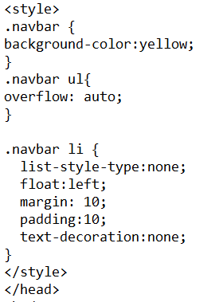
CSS Navigation bar

Slide 5
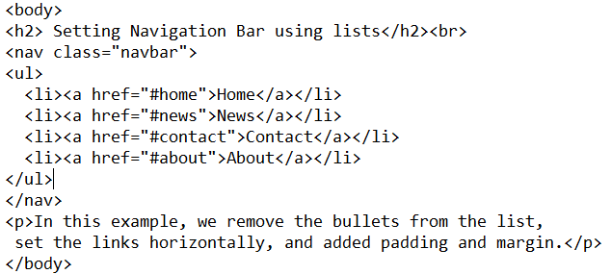
Navigation bar

Slide 6
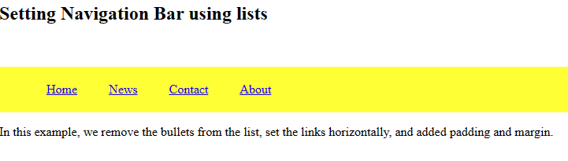
Navigation bar

Slide 7
Styling Image gallery
<style>
div.gallery {
margin: 10px;
border: 10px solid #ccc;
float: left;
width: 180px;
}
div.gallery img {
width: 100%;
height:20% ;
}
</style>
<div class="gallery">
<img src="sc1.jpeg" width="600“ height="400">
<p> add some description here</p>
</div>

Slide 8
Styling Image gallery
<body>
<h1> Working with image gallery</h1>
<div class="gallery">
<img src="sc1.jpeg" >
<p> add some description here</p>
</div>
<div class="gallery">
<img src="sc2.jpeg" >
<p> add some description here</p>
</div>
<div class="gallery">
<img src="sc3.jpeg" >
<p> add some description here</p>
</div>
<div class="gallery">
<img src="sc4.jpeg" >
<p> add some description here</p>
</div>
<div class="gallery">
<img src="sc5.jpeg" >
<p> add some description here</p>
</div>
</body>

Slide 9
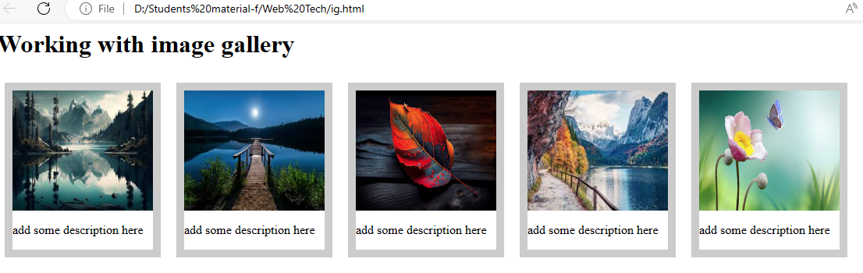
Styling Image gallery

Slide 10
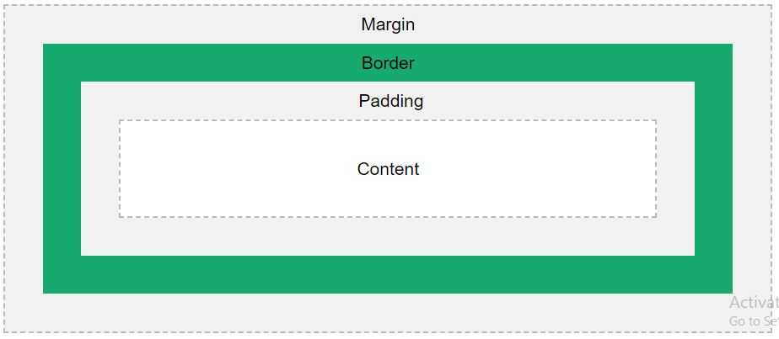
The CSS Box Model
In CSS, the term "box model“ refers to design and layout.
The CSS box model is essentially a box that wraps around every HTML element.
It consists of: content, padding, borders and margins.

Slide 11
The CSS Box Model
Content - The content of the box, where text and images appear
Padding - Clears an area around the content. The padding is transparent
Border - A border that goes around the padding and content
Margin - Clears an area outside the border. The margin is transparent

Slide 12
The CSS Box Model
<html>
<head>
<style>
div {
width: 300px;
border: 20px solid blue;
padding: 25px;
margin: 20px;
background-color: lightgreen;
}
</style></head>
<body>
<h1> Working with box model</h1>
<div> Pakistan, officially the Islamic Republic of Pakistan,
is a country in South Asia. It is the fifth-most populous country,
with a population of over 241.5 million, having the
second-largest Muslim population as of 2023.
Islamabad is the nation's capital, while Karachi is its
largest city and financial centre.
</div>
</body> </html>

Slide 13
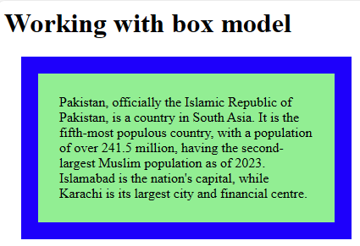
The CSS Box Model

Slide 14
Styling Forms
To style HTML forms with CSS selectors and techniques to enhance user experience and form functionality.
It includes styling
Input Fields
Padded Inputs
Bordered Inputs
Colored Inputs
Focused Inputs
Input with icon/image

Slide 15
Styling Forms
<style>
input[type=text], select {
width: 50%;
padding: 12px 20px;
margin: 8px 10;
border: 10px solid #DDAA00;
}
input[type=text]:focus {
border:5px solid blue;
}
input[type=submit], [type=reset] {
width: 30%;
background-color: #DDAA00;
color: white;
padding: 14px 20px;
margin: 8px 0;
}
</style>

Slide 16
Styling Forms
<body>
<h3>Using CSS to style an HTML Form</h3>
<div> <form >
<label for="fname">First Name</label>
<input type="text" id="fname" name="firstname" placeholder="Your name.."><br>
<label for="lname">Last Name</label>
<input type="text" id="lname" name="lastname" placeholder="Your last name.."><br>
<label for="country">Country</label>
<select id="country" name="country"><br>
<option value="pakistan">Pakistan</option>
<option value="australia">Australia</option>
<option value="canada">Canada</option>
<option value="usa">USA</option>
</select><br>
<input type="submit" value="Submit">
<input type="reset" value="Reset">
</form></div></body>

Slide 17
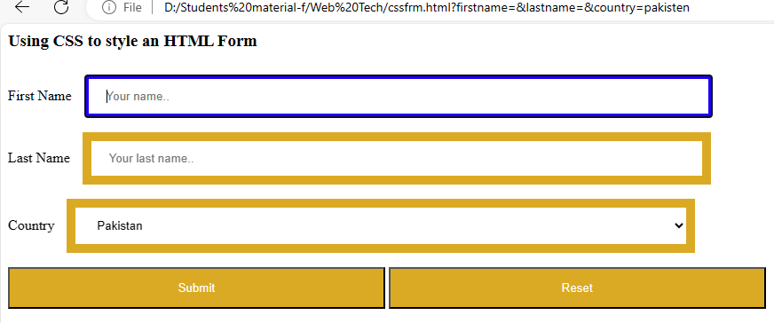
Styling Forms

Slide 18
Grid Layout
The CSS Grid Layout Module offers a grid-based layout system, with rows and columns, making it easier to design web pages without having to use floats and positioning.
A grid layout consists of a parent element, with one or more child elements.

Slide 19
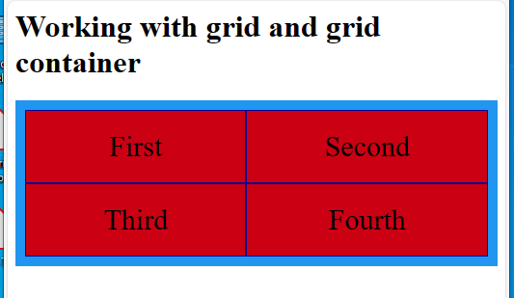
Grid Layout
<style>
.grid-container {
display: grid;
grid-template-columns: auto auto;
background-color: #0096F3;
padding: 10px;
}
.grid-item {
background-color: rgb(205, 00, 00);
border: 1px solid rgb(0, 0, 150);
padding: 20px;
font-size: 30px;
text-align: center;
}
</style>
<body>
<h1>Working with grid and grid container</h1>
<div class="grid-container">
<div class="grid-item">First</div>
<div class="grid-item">Second</div>
<div class="grid-item">Third</div>
<div class="grid-item">Fourth</div>
</div>

Slide 20
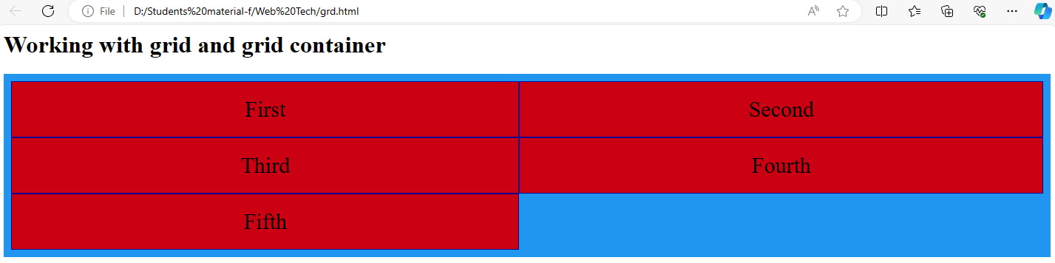
Grid Layout
<div class="grid-container">
<div class="grid-item">First</div>
<div class="grid-item">Second</div>
<div class="grid-item">Third</div>
<div class="grid-item">Fourth</div>
<div class="grid-item">Fifth</div>
</div>

